Slide 1
OLEI Survey
ELRC Final Presentation
Andres Santiago
Jacob Mathes Brandon Nguyen
Chengyuan Qian
Minseo Park
Yi-Ting Lee

Slide 2
Introduction
This project is the start of a journey to bring the Synergistic Leadership Theory, a modern take on leadership theory, into a practical and interactive web application.
The mission is to develop a platform that not only educates on the theory but also allows users to assess leadership effectiveness through the Organization and Leadership Effectiveness Inventory (OLEI).

Slide 3
Introduction
Stakeholders include Dr. Beverly Irby and Dr. Matthew Etchells, alongside a team of students committed to transcending traditional, male-dominant leadership paradigms.
The platform features an animated, interactive tetrahedral model representing the theory's core factors:
Leadership Behaviors
Organizational Structure
External Forces
Attitudes, Values, and Beliefs.
This tool will facilitate a deeper understanding of leadership dynamics but also generate personalized leadership style analysis.

Slide 4
OLEI Survey
Primary use cases:
Educate interested parties on how the OLEI Survey intends to utilize the Synergistic Leadership Theory.
Analysis of leadership synergism between Principal, Teachers, Superintendent.

Slide 5
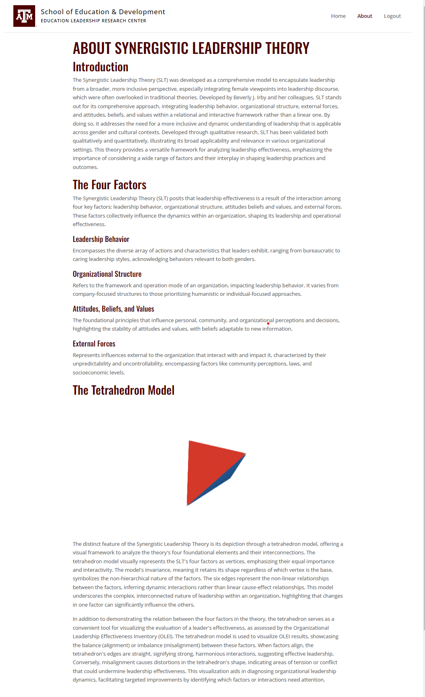
OLEI Survey - Education
Our application hosts a dedicated ‘about’ page providing educational content regarding the Synergistic Leadership Theory (SLT).
In addition to providing information regarding the origin, development, and applications of the SLT, the page explains the OLEI Survey tool and its associated interactive tetrahedron model.

Slide 6
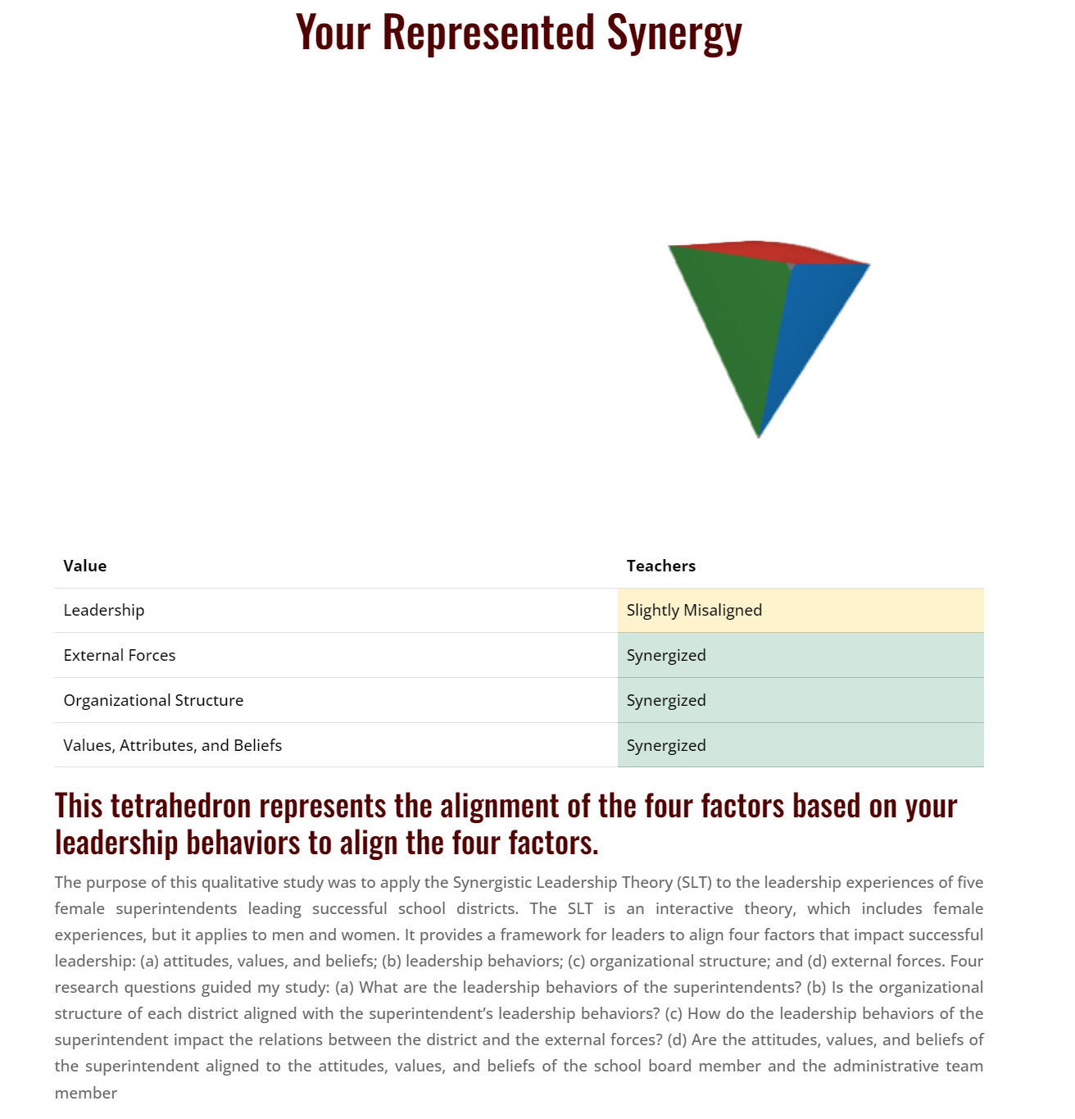
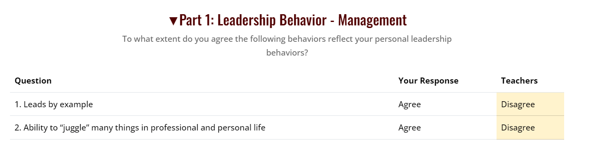
OLEI Survey - Analysis
Main function of application is the analysis of leadership style synergies
This was accomplished using the OLEI survey tool, based on the Likert scale with questions oriented towards leadership style
When the different levels of leadership fill out the survey on a specific individual, the individual’s style will be compared to the rest for synergy and alignment

Slide 7

OLEI Survey - The Interactive Model
The OLEI uses a bulging tetrahedron to intuitively visualize the alignment between a leader and their organization.

Slide 8
Design - Methodology
Agile Development Lifecycle:
For this project we elected to adhere to the Agile Methodology for best development practices. This meant we developed our project over the course of four sprints, each marking a unique minimum viable product (MVP) and a period of documentation and reflection.
This methodology also entailed bi-weekly Scrum meetings with the development team and weekly meetings with the sponsor, such that all parties were up-to-date on development tasks, client expectations and products.

Slide 9
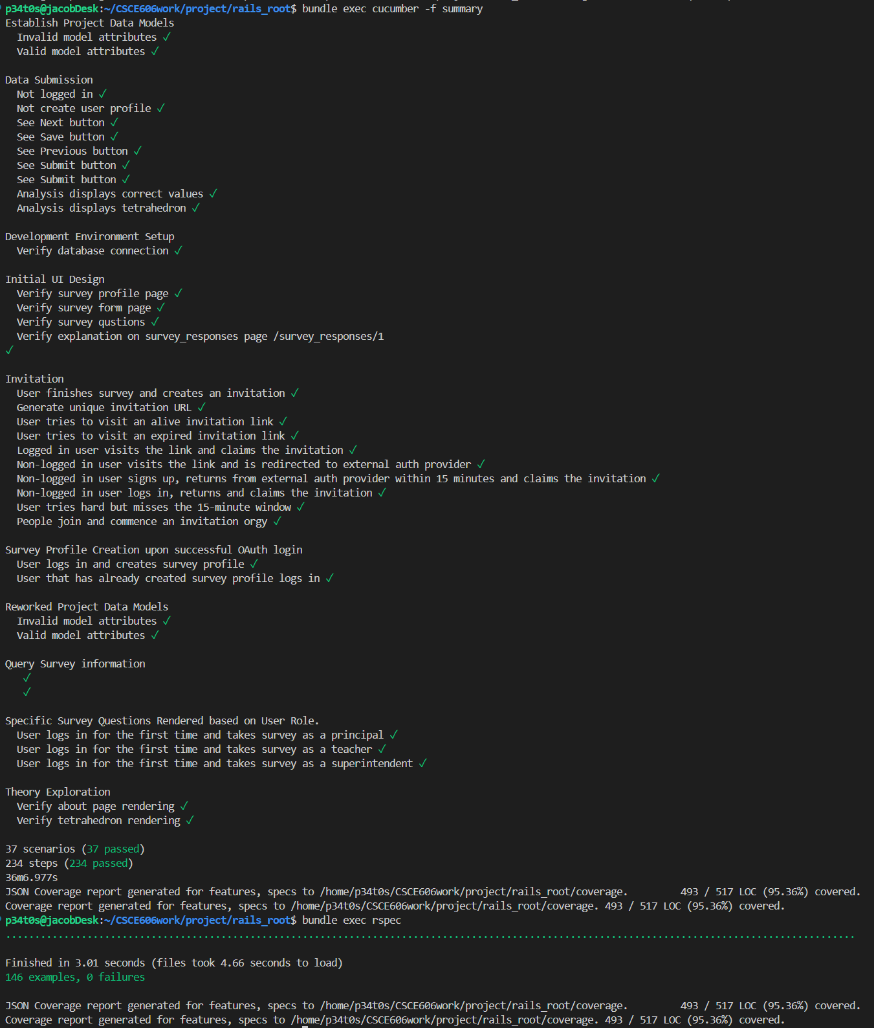
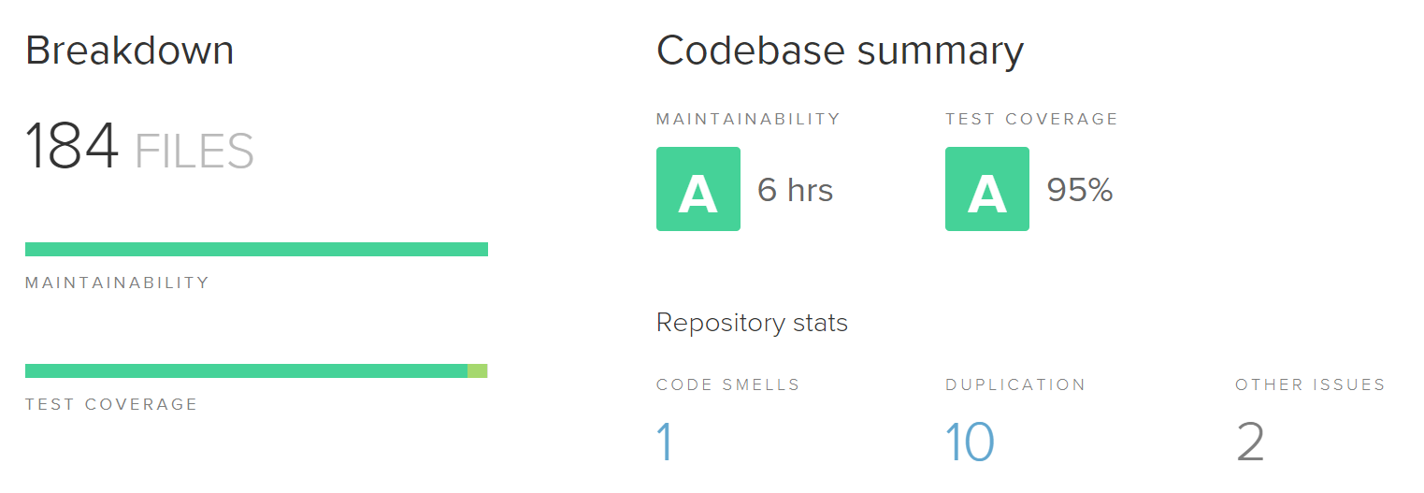
Design - Development Practices
Test and Behavior Driven Development (TDD / BDD):
In each sprint, new feature tests were developed BEFORE the features themselves.
This meant that we had a functional criteria for each feature before any actual implementation time was spent on that feature.
This tremendously reduced the debugging time for each sprint, and ensured that we had a rich test suite for all existing features going forward.

Slide 10
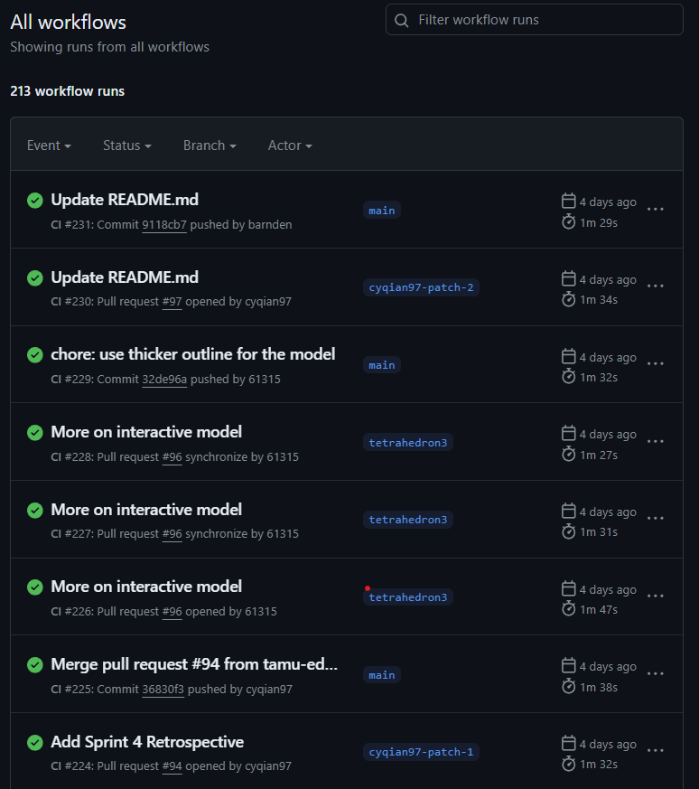
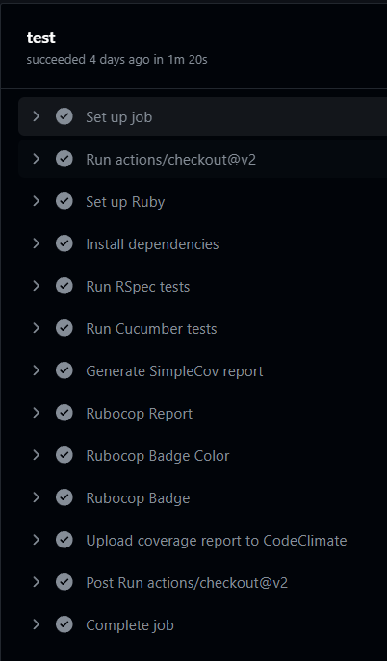
Design - Development Practices
Continuous Integration / Continuous Deployment (CI/CD):
GitHub Actions runs RSpec and Cucumber tests on code ready to be deployed
Only code that passes all tests can be merged to main branch and deployed

Slide 11
Challenges
Translation of Theory to Application:
Given the sponsors’ depth of research and design done on the OLEI to utilize the SLT, there was considerable time spent making sure the development team knew the ‘why’, as well as the ‘what’ we were implementing. This became less of a challenge as the semester progressed, but was one of our larger challenges in the early stages of the project.
New Frameworks:
With none of our project team members having had previous experience with Ruby on Rails, there was a high pressure early on to gain hands on experience with the framework so that we could meet the project requirements and provide the sponsor with a meaningful product.

Slide 12
Lessons Learned
Gaining clear understanding of client expectations:
With our limited project time-frame and a wealth of different applications for the SLT, it became clear early on that we needed to know exactly what our client wanted us to deliver at all times, such that we were using both the sponsors’ time and our own development time to the fullest extent.
Importance of writing testable, reusable code:
With our application having multiple primary use cases, and various other user stories, it was important to make sure that we always had a minimum viable product for all use cases available to the sponsor. This was done in our project by performing routine smoke tests and utilizing test-driven development to make sure all application dependencies and use case paths were satisfied.

Slide 13
Thank You

